Slide 1

Alexandre Menais
Executive Vice President
Group Head of Mergers and Acquisitions
Corporate Development
Group General Counsel

Slide 2

Cyber Security: How to protect our innovative activities
ATOS CYBER SECURITY: N1 IN EUROPE, GLOBAL REACH

Slide 3

Cyber Security: How to protect our innovative activities
THE EVER CHANGING SECURITY LANDSCAPE
Continuously changing threat landscape
Shift from Legacy Security to Security Intelligence
Moving from Point Solutions to Actionable Intelligence (AI & Big Data) for a 360° security management
The changing nature of Privacy
60%
of enterprises
will suffer
major breaches
by 2020
(Gartner)
The question is
not if, but when
a cyber breach
will happen

Slide 4





Cyber Security: How to protect our innovative activities
The Threat Landscape is continuously changing. It’s a race against complexity & time
Attack surface
is expanding
Attack actors
are motivated
Attack vectors
are more targeted & complex
Endpoint
Insiders
Ransomware
Network
Hacktivists
Cross-platform malware
Mobile
Organized Crime
IoT botnet
IoT
Nation Sponsored
Crypto jacking/Drive-by mining
Cloud
Watering hole
Industrial Systems
Spear phishing/ whaling
    DDoS Smokescreening
IMPACT OF CYBERATTACKS
Loss of data Decrease of Trust Decrease in Company Value Rising cost Fines & Sanctions

Slide 5
Cyber Security: How to protect our innovative activities
Industry in constant renewal
Source: Gartner, Forrester, Atos research

Slide 6
Cyber Security: How to protect our innovative activities
Shift from Legacy Security to Security Intelligence. Atos vision: Be prepared for the unexpected

Slide 7
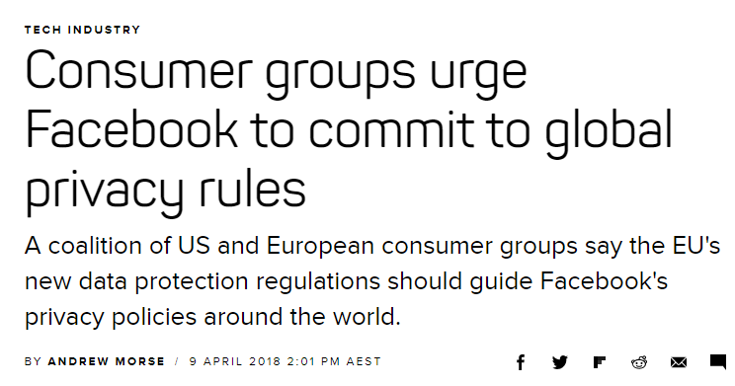
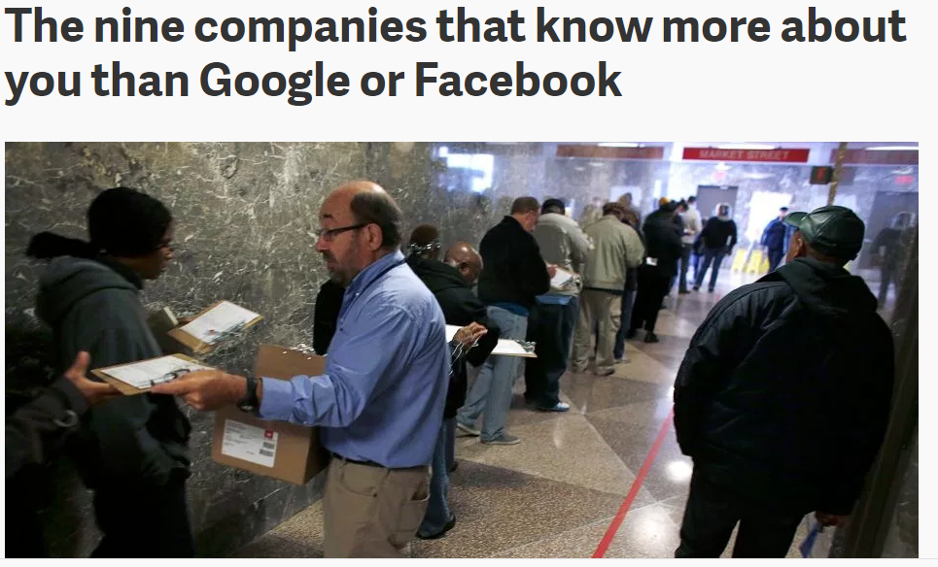
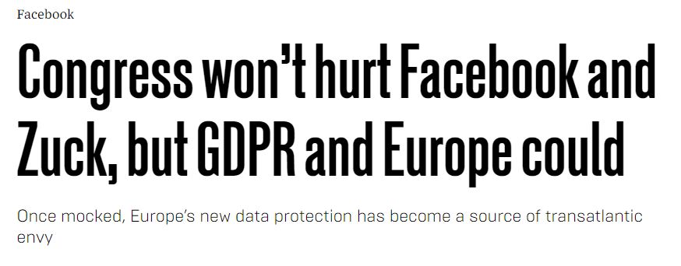
Cyber Security: How to protect our innovative activities
The changing nature of Privacy. The shift in public perception. Did Facebook open the Pandora Box ?

Slide 8
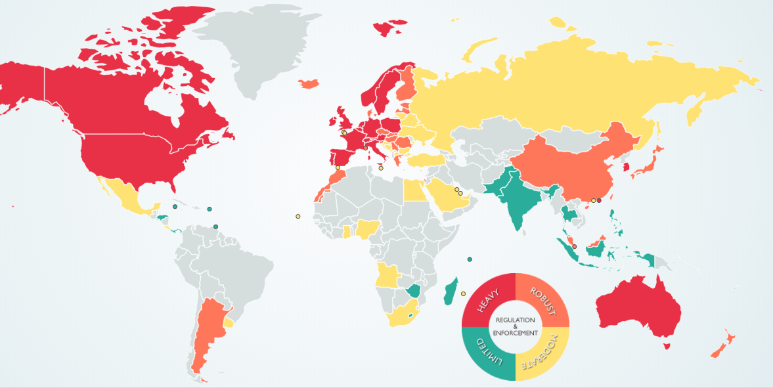
Cyber Security: How to protect our innovative activities
Towards a Global Privacy Treaty ?
EU:
GDPR
e-privacy directive
NIS directive
Local National Guidance
National Adaptation
Article 29 WP

